Slide 1
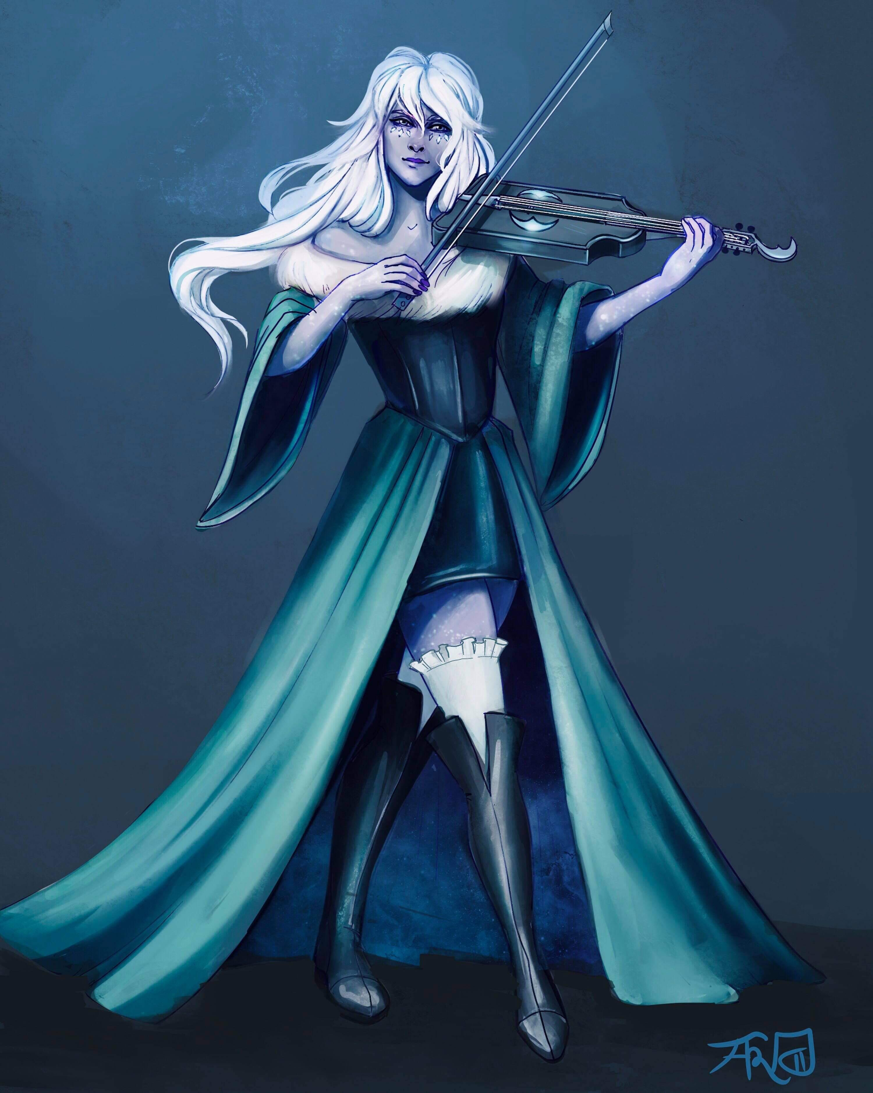
Bethany [Last Name UNKNOWN]
Assistant at the Day Dream Library
Loves to play Viola and wants to prove her worth by joining the Flatcoat Circus.
Currently in a relationship with Desparia.

Slide 2
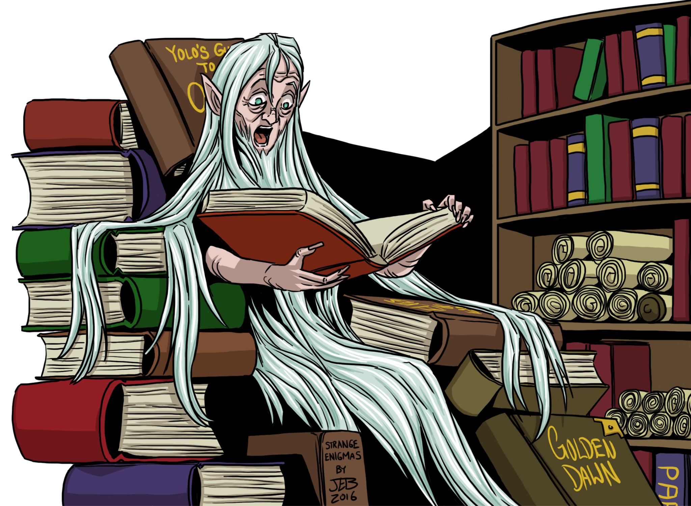
Luanda Hushbringer
Owner of the Day Dream Library

Slide 3
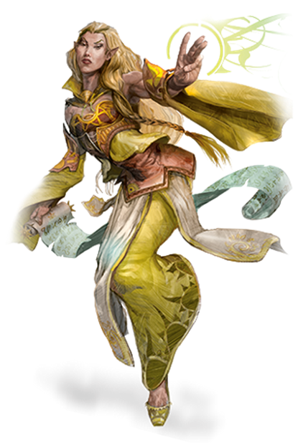
Ramora [Last Name UNKNOWN]
Traveling Adventurer
Works Part-Time at the Day Dream Library
Extremely interested in any ancient artifact

Slide 4
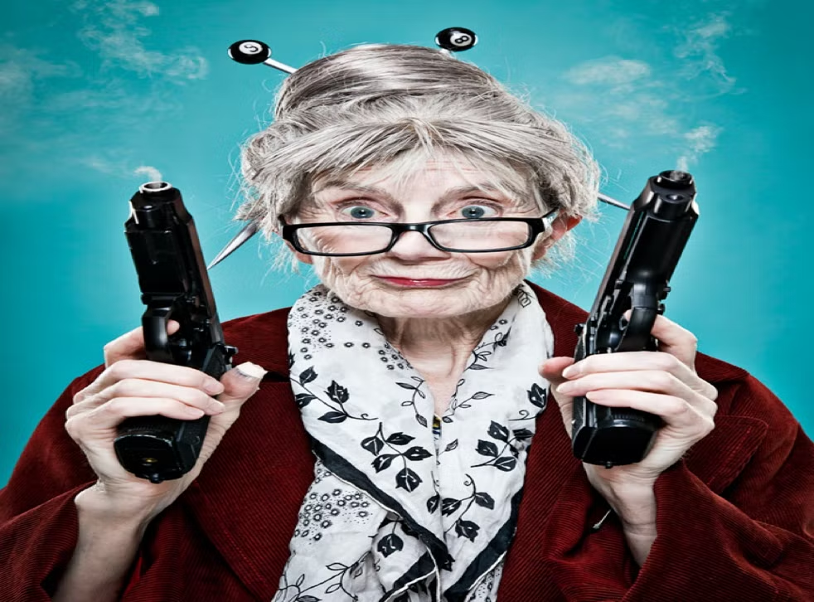
Swan [Last Name UNKNOWN]
Owner of The Thoughtful Baker Bar
Extremely quick when getting drinks and food.

Slide 5
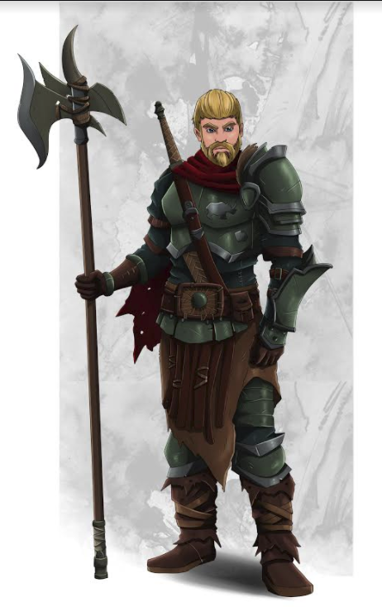
Rhino Varaati
Ex-Arm Wrestling Champion of Helmfield
Depressed due to the current state of his life
Family took in Penguin as a child and raised him as their own.
Got crossed at the Party’s celebratory night and attacked Kyle while in a blind rage.

Slide 6
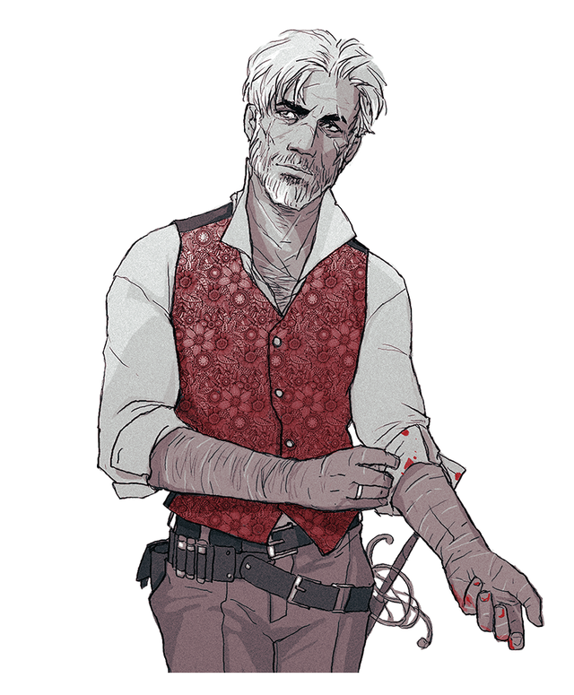
Penguin Varaati/???
Adopted brother of Rhino’s Family
Very protective over Rhino, and good at calming him down.
Warlock gaining power from the left hand to Verrona’s God.

Slide 7
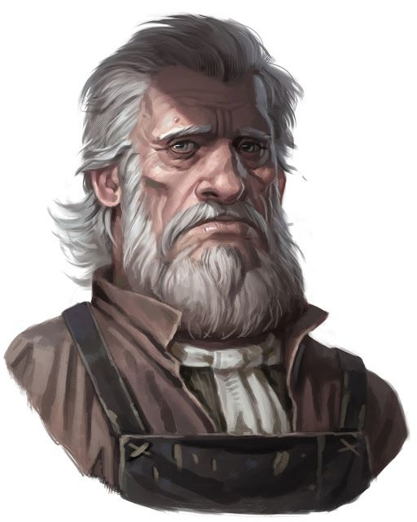
Sunseer Leonhard
Owner of the White Basin Hotel
Upset due to the loss of his lovely wife but wants to try and move on.
In a relationship with Hydrangea.

Slide 8
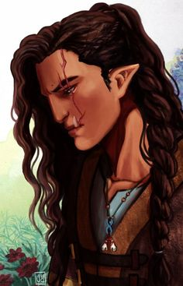
Beverly Caskbow
Owner of the Flowing Hammer
Got her scar from the Helmfield Cave
Joined you in the Helmfield Cave.
Scared to go out on more adventures and is comfortable working as a blacksmith
Level 3 - Barbarian
STR | DEX | CON | INT | WIS | CHA
19 (+4) | 8 (-1) | 19 (+4) | 7 (-2) | 7 (-2) | 10 (+0)

Slide 9
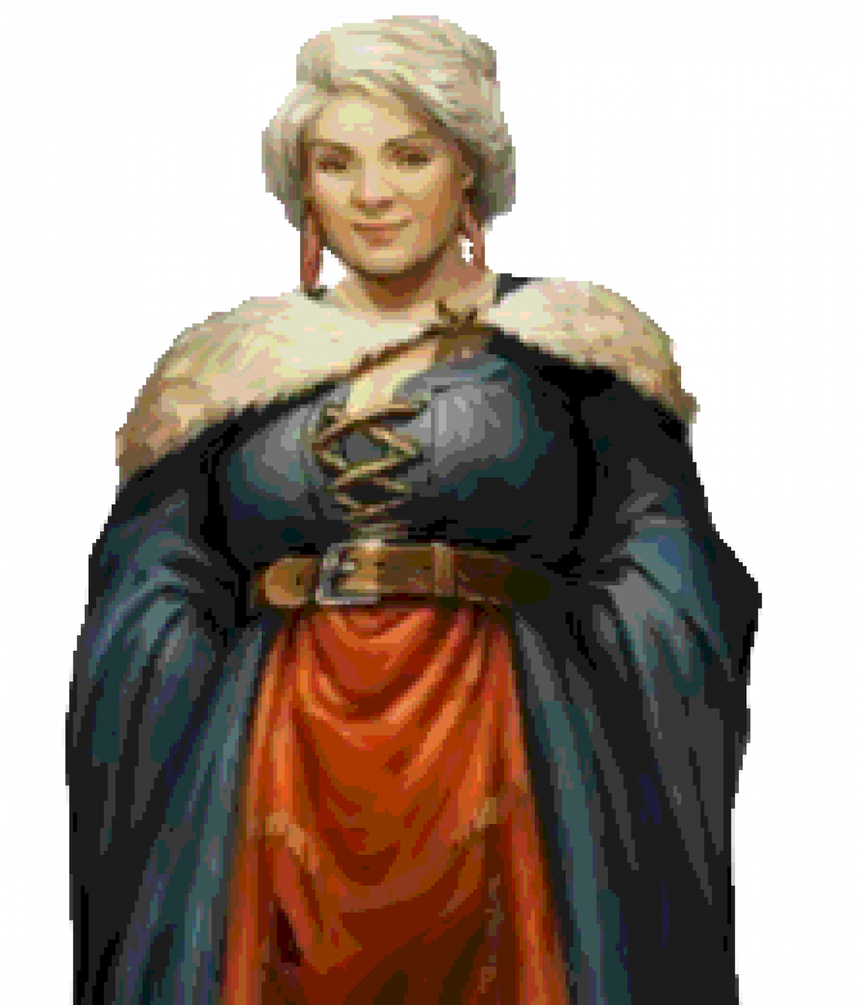
Godiva Commonbrook
Mayor of Helmfield
Her motto: “The people are first, the government is corrupt and make everyone happy!”

Slide 10
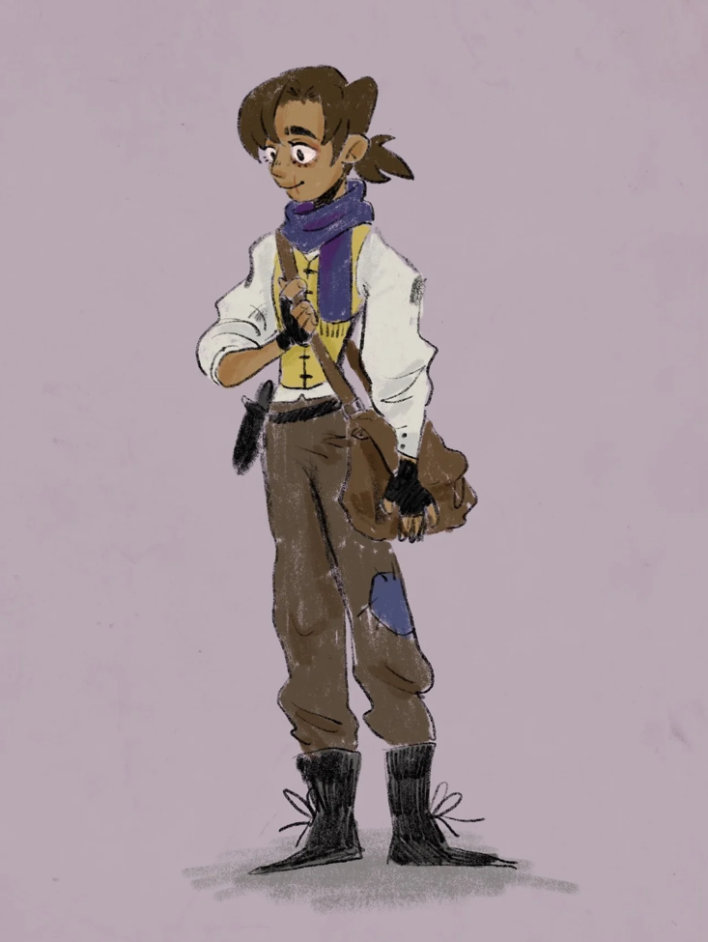
Kyle ???
Beat Rhino in Arm Wrestling due to the help of the party
Is scared of Rhino

